Slide 1


Unique Value Proposition Workshop for Consultancies
Workshop

Slide 2

Contents
Workshop Guidance
Prior to Workshop
6 Step Workshop

Slide 3
This presentation shows you how to develop your UVP through a workshop.
This should be an enjoyable, inclusive effort. Make it an occasion to build your team!
Don’t focus on what you offer now, but what you could be in 1-2 years!
Workshop Guidance

Slide 4

Aim to create unique, compelling and targeted propositions that command market attention.
If you're in the 'me too' zone you’re doing something wrong.

Slide 5

Workshop Preparation

Slide 6

PRE-READING
  Strategy
  Niche / Avatar Statement
  Values & Culture Statements
  Competitor Analysis
  Market Analysis
Workshop Preparation
Read Unique Value Proposition at www.consultingmastered.com/growth

Slide 7





Use a room with post-its. Get people on their feet. Temper headstrong personalities.
Use and mix up break-outs. Activities should be done in small groups and bought together.
Do not vote on anything. Avoid groupthink or decision by committee.
Workshop facilitation by a senior client or an independent experienced facilitator (ahem!).
Consider not inviting the partners until the end. Perhaps using pitches to sell different UVPs to the leadership.
This should be done by those that deliver AND sell the work .

Slide 8

Six Step Workshop

Slide 9
1. TOP DOWN
In pairs review each document to find five phrases why your ideal client would buy from your firm.
Think about the way you work, your values, your way of working, the type of people you employ, what you are most passionate about and what you’re great at.

Slide 10

2. BOTTOM-UP
In pairs review each service-line to identify the client value it brings.
Think of the problems it solves or the opportunities it fulfils.
Use the language of your clients and their pain-points / concerns

Slide 11
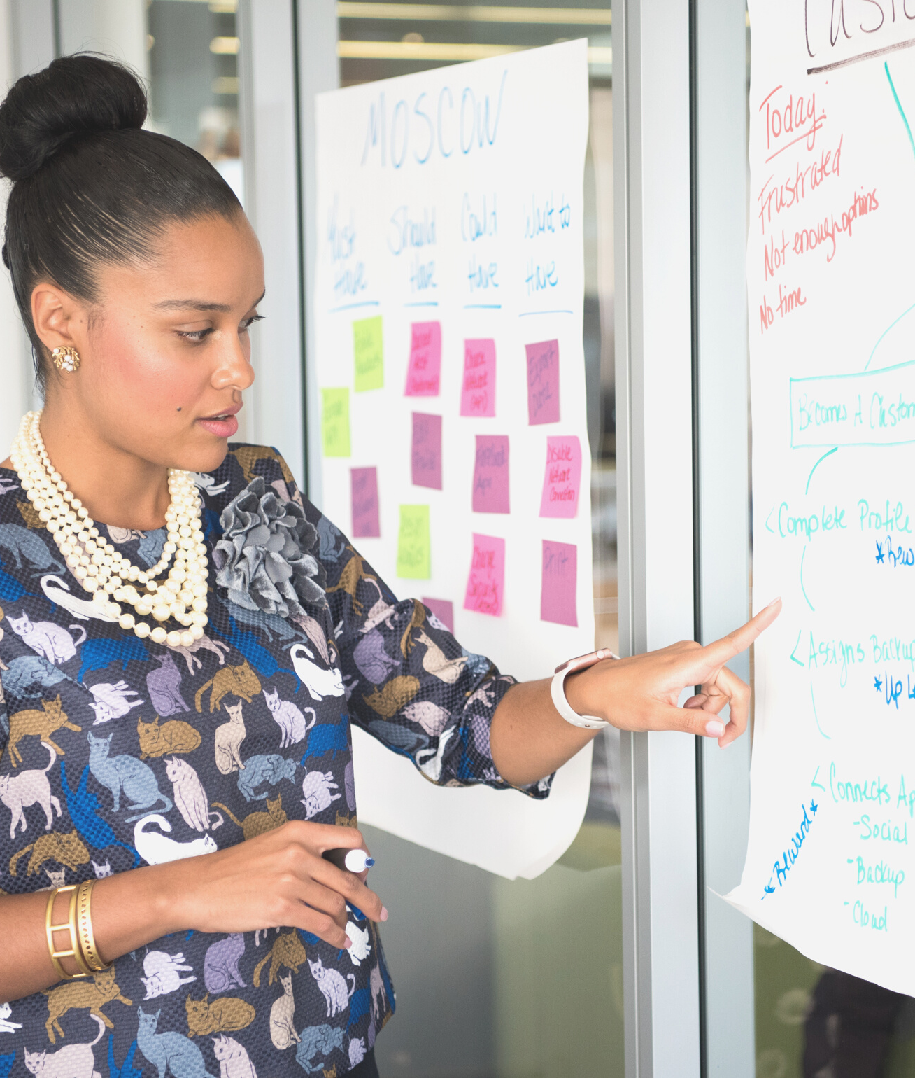
3. VALUE SCORING
  Score each phrase out of 3 in terms of how important these are your clients
  Remove anything that scores less than 2

Slide 12

4. UNIQUE SCORING
  Review your competitor analysis
  Score each phrase out of 3 as to whether your competitors do these well.
  Remove anything that scores less than 2

Slide 13
Workshop
5. CRAFTING
Bring together both sets of surviving post-its
Translate your phrases into the language of your clients
Each pair to create 3 sentences that best encapsulate your unique value
- One describing what you achieve for your clients they value most
- One describing how you achieve this
- One providing more detail on the client benefits
Avoid vanilla at any cost, if you appeal to everyone, you appeal to no-one.

Slide 14

6. REVIEW & IMPROVE
  Whittle down to one UVP
  Review within the organisation, with stakeholders and with clients
  Plan the launch!

Slide 15

Review your UVP every year, every time you launch a new service or market, and every time you are facing radical market changes

Slide 16
www.joeomahoney.com

