Slide 1


Workshop
Service Strategy & Planning Workshop for Consultancies
Prof. Joe O’Mahoney

Slide 2

Service strategy 101
Coding Services & Markets
Services development plan
(Cross-)selling plan & targets
Resource allocation
Contents

Slide 3

Workshop Preparation

Slide 4

Consider inviting some clients?

Slide 5

EXAMPLE MARKET PRIORITISATION
Market size
Competition
Growth
Existing client presence
Contacts
For each market you are considering, score these factors to see which you might enter next.

Slide 6
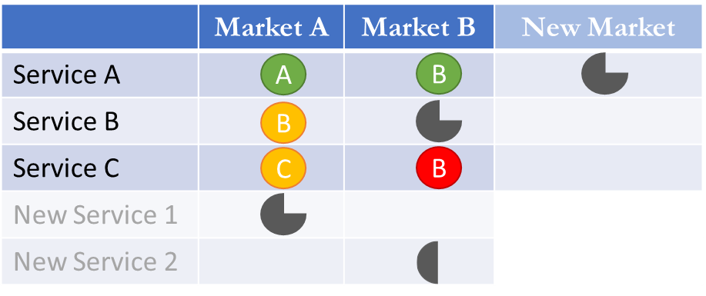
Example Coding

Slide 7

CODING
Code your services for profitability (green to red)
Code your markets for priorities (A to C)

Slide 8

ALL TO HAVE READ
  Corporate strategy
  Market research
  Service coding & service financials

Slide 9




Use a room with post-its. Get people on their feet. Temper headstrong personalities.
Walk-through service strategy 101
Agree coding for services & market priorities.
Agree development plan for services
Develop Cross-Selling Activities
Agree resource allocation

Slide 10

Five Step Workshop

Slide 11

1. SERVICE STRATEGY 101

Slide 12

SERVICES THAT MAXIMISE PROFITS
Maximise revenue
Minimise costs
Cross-sell between profitable markets
Cross-sell with other services

Slide 13
Signature : Your best, dominant, highest margin, core services.
Complimentary: vertical or horizontal integration & cross-sell.
Follow-on/Fall-back service

Slide 14
2. AGREE SERVICE PRIORITIES
Agree / amend coding of services/markets
Prioritise service/market activities
Create stretch targets for service sales

Slide 15
Workshop
3. SERVICE DEVELOPMENT PLAN
Together (if you’re small) or in break-outs (if you’re large)….
Use the list on next page to prioritise ideas for how you can…..
A. …. Develop (add value to) your services
B. …. Reduce costs of delivery
C. …. Increase prices / change pricing structure
D. …. Undertake research to support these activities
3. Assign responsibilities for service research & development
4. Report back with research, costs, benefits & business case

Slide 16
Ideas for service development
Templates & tools
Process or method
Peer group network
Expert group
Accreditation
Simulation
Licencing
Freemium
Database access
Research reports
Benchmarking/maturity
Video Course
Apps/Software
Games
Research report / survey
Franchising
Pay per use
Workshop

Slide 17

4. CROSS-SELLING PLAN
  Create activities & timelines for maximizing cross-selling both same services into new markets and new services into existing markets

Slide 18

5. RESOURCE ALLOCATION
  Use stretch targets & service development plan to allocate resources to key activities.

Slide 19
joe@consultingmastered.com

